Slide 1
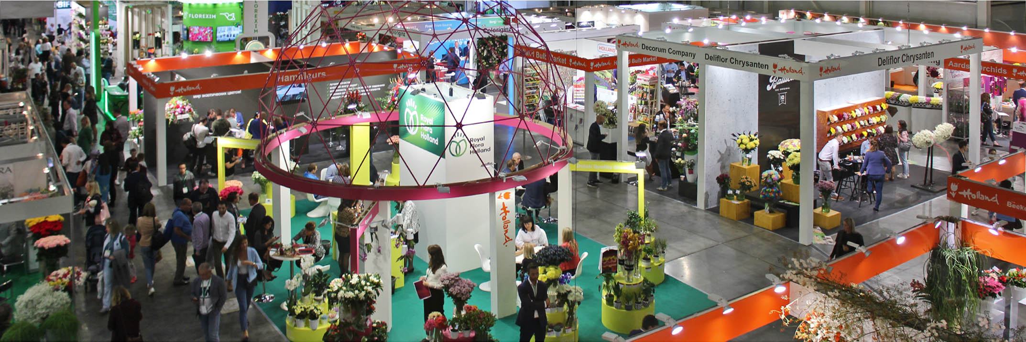



FlowersExpo-2019
International trade fair
on floriculture and green industry
The main exhibition of the year for your business in Russia!
10 - 12 September, 2019
International Exhibition Center Crocus Expo
Moscow, Russia

Slide 2
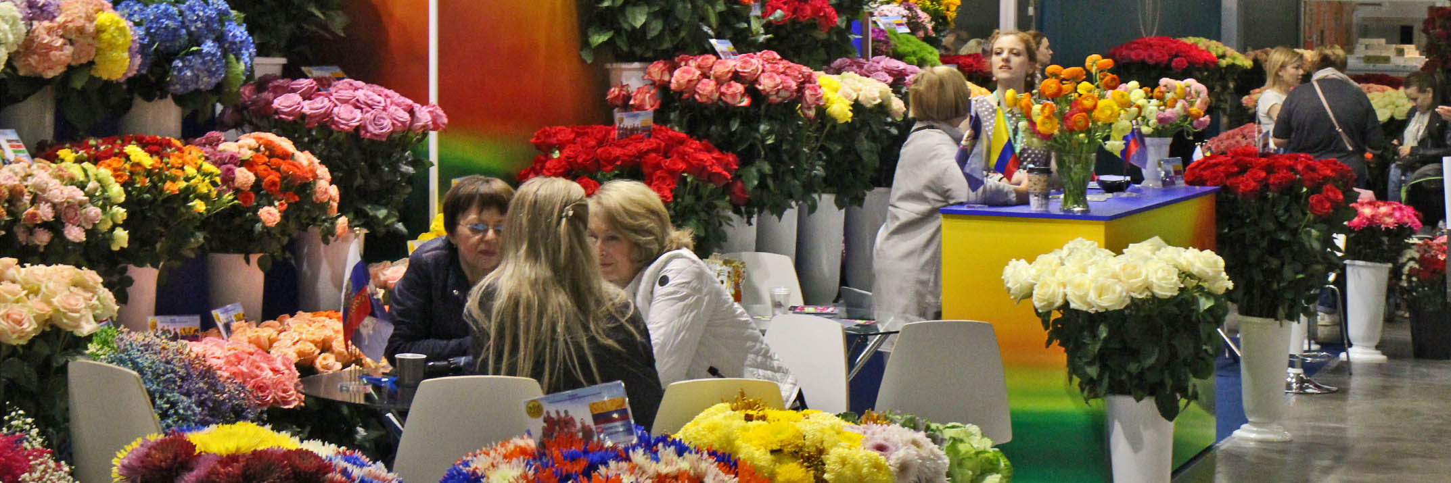

International Exhibition
FlowersExpo
Unique platform presenting all segments of flower industry, floristics and landscape design
Miniature model
of the Russian flower and plant market
The best Russian exhibition
on Floriculture, Floristics. Gardening, Landscape Design
in all categories (exhibition space, international representation, professional interest, market coverage)
by results of the All-Russian Rating
of Exhibitions in 2017/18, held by the Russian Union of Exhibitions and Fairs

Slide 3
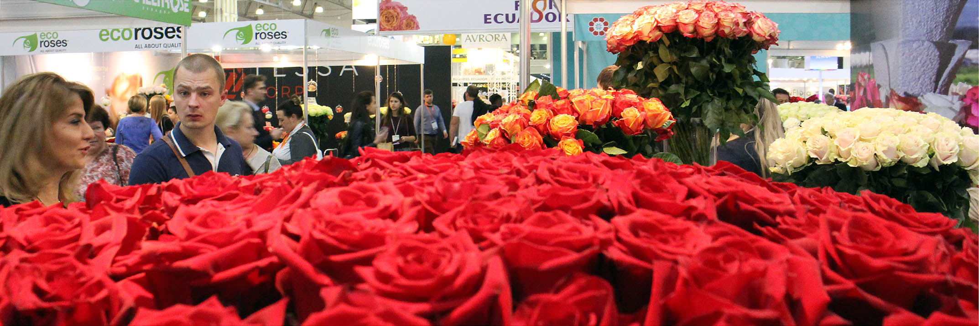
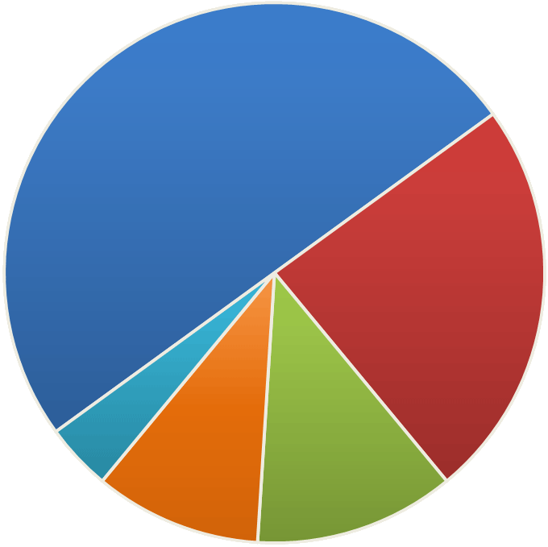

Main Exhibition Sectors
Cut flowers and potted plants
Nursery Sector, Landscape
and Ecology
50%
24%
Flower Arrangement and Design
12%
4%
10%
Related products
Equipment
and Technologies
Novelties, innovations, trends
are in the focus of the fair

Slide 4
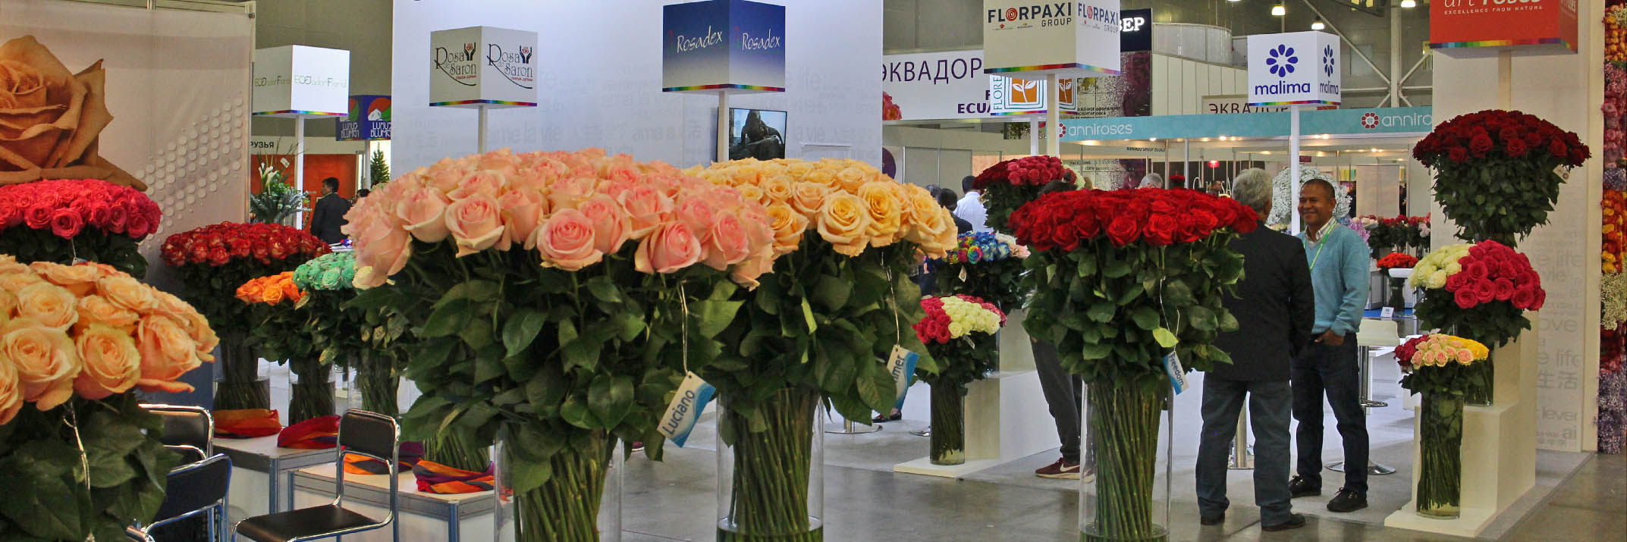
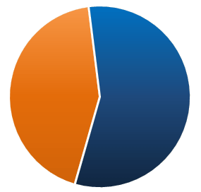

FlowersExpo-2018
Statistics
420 companies from 25 countries
took part In the exhibition
The products and services were represented by
5,000 domestic and international professionals
and experts
Russian participants
Foreign participants
183
237

Slide 5
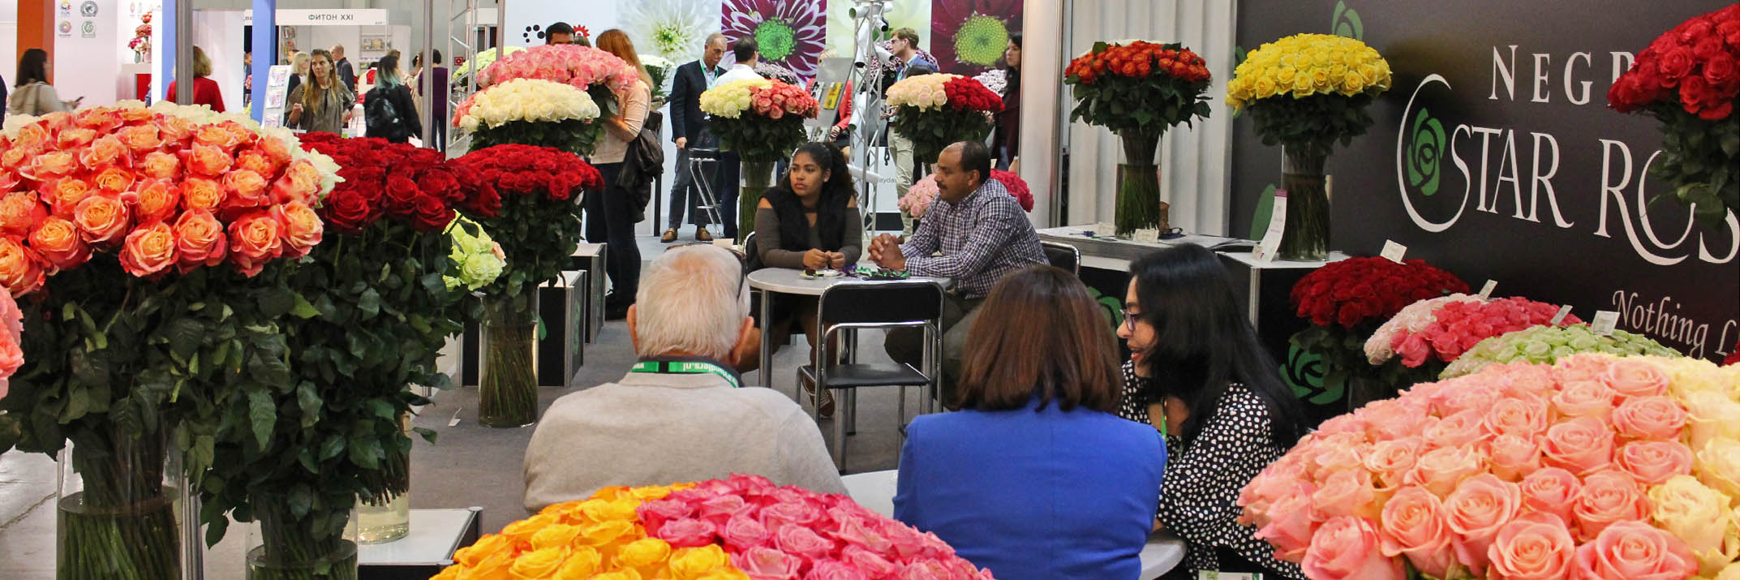
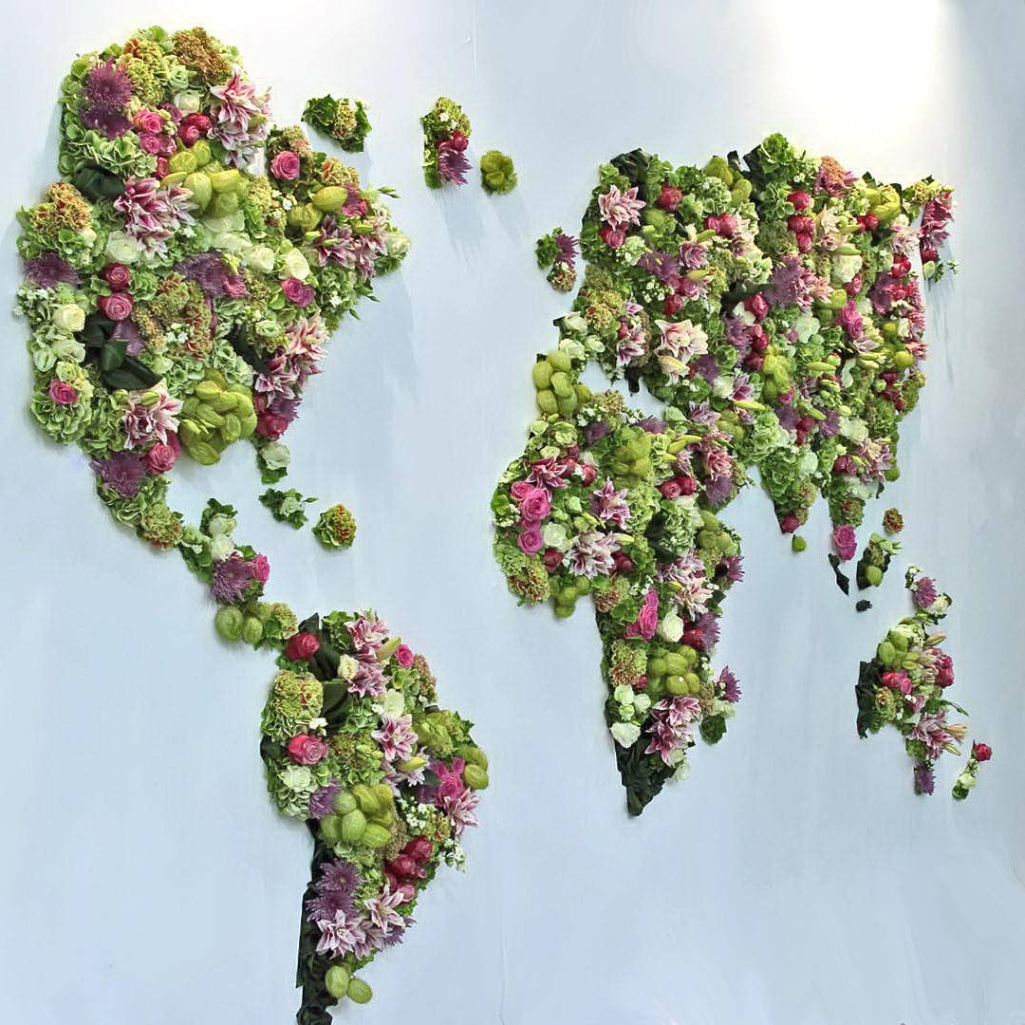
Belarus, Belgium, China, Columbia, Denmark, Ecuador, Finland, France, Germany, Great Britain, India, Israel, Italy, Japan, Kazakhstan, Kenia, Korea, Malta, Netherlands, Poland, Russia, Serbia, Sri Lanka, Thailand, UAE, USA, Venezuela

Slide 6
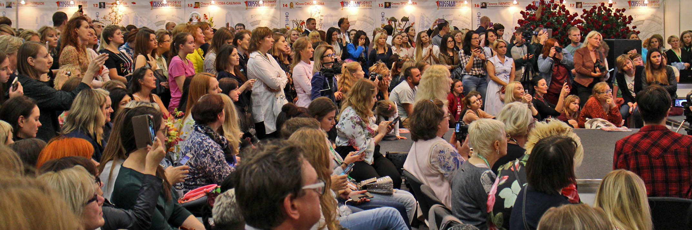
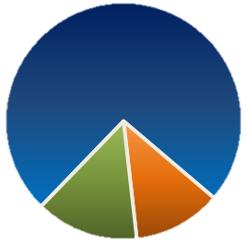
Visitors
The exhibition was visited by 12 000+ specialists and representatives
of business circles from 75 regions of Russia, 249 Russian cities.
Foreign guests arrived from 45 countries
Qualitative Structure of Visitors
Private persons
Specialists, associated with flowers and plants
12%
74%
Other specialists
14%
Spheres of Activity of Visitors
Retail
Wholesale
Other
Landscape company
Floristic salon
Production enterprise
Greenhouse complex
Nursery
Design studio
Logistic service
Importer / Exporter
Distributor / Dealer
Building company
Architect bureau

Slide 7
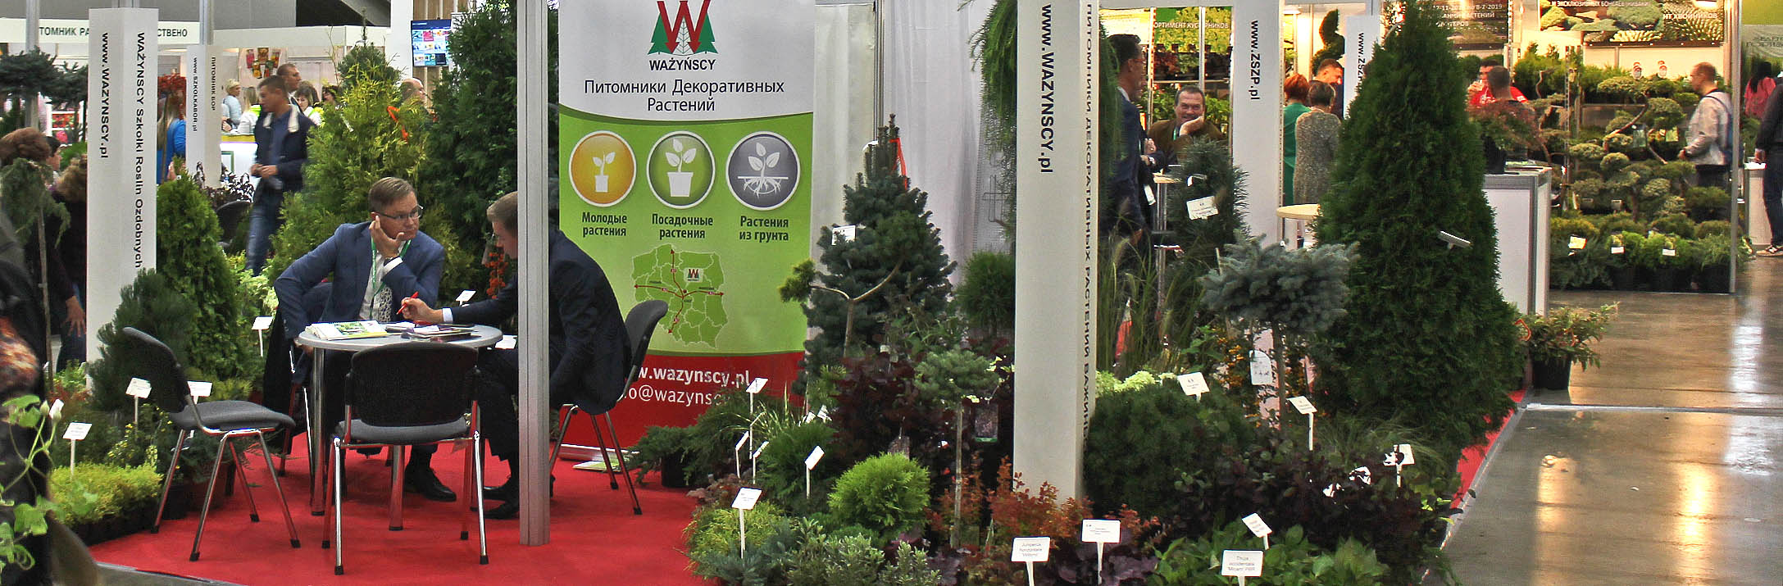

Visitors’ Interests and Preferences
Floristics and Design
Cut flowers and potted plants
Interior décor and decorative articles
Accessories and floristic packaging
Seeds and flower planting stocks
Products for gardens and gardening
Fertilizers, soil, plant protection means
Ornamental trees and shrubs
Equipment for garden centers and retail
Landscape design
Equipment for greenhouses and nurseries
Logistic services
Others
Visitors’ Competence in Making Decisions
Make decisions
32%
Do not take part in making decisions
Take part in
making decisions
38%
30%

Slide 8
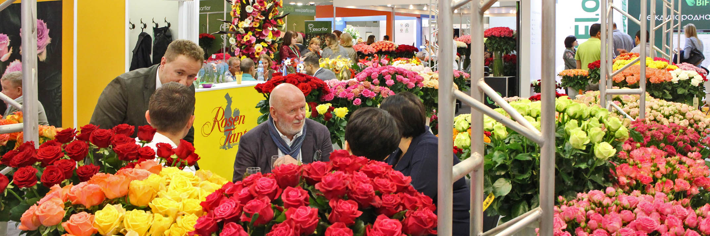
Opportunities and Advantages of FlowersExpo-2019 Participants
To present themselves at the prestigious international exhibition among the leading companies of the sector
To find new clients, to meet partners, to assess consumers interest to the product and to conduct other marketing studies
To attract the attention of 12000+ professional visitors from all Russian regions and 45 countries
To receive favorable conditions for contacts in B2B format at the more modern exhibition center Crocus Expo

Slide 9
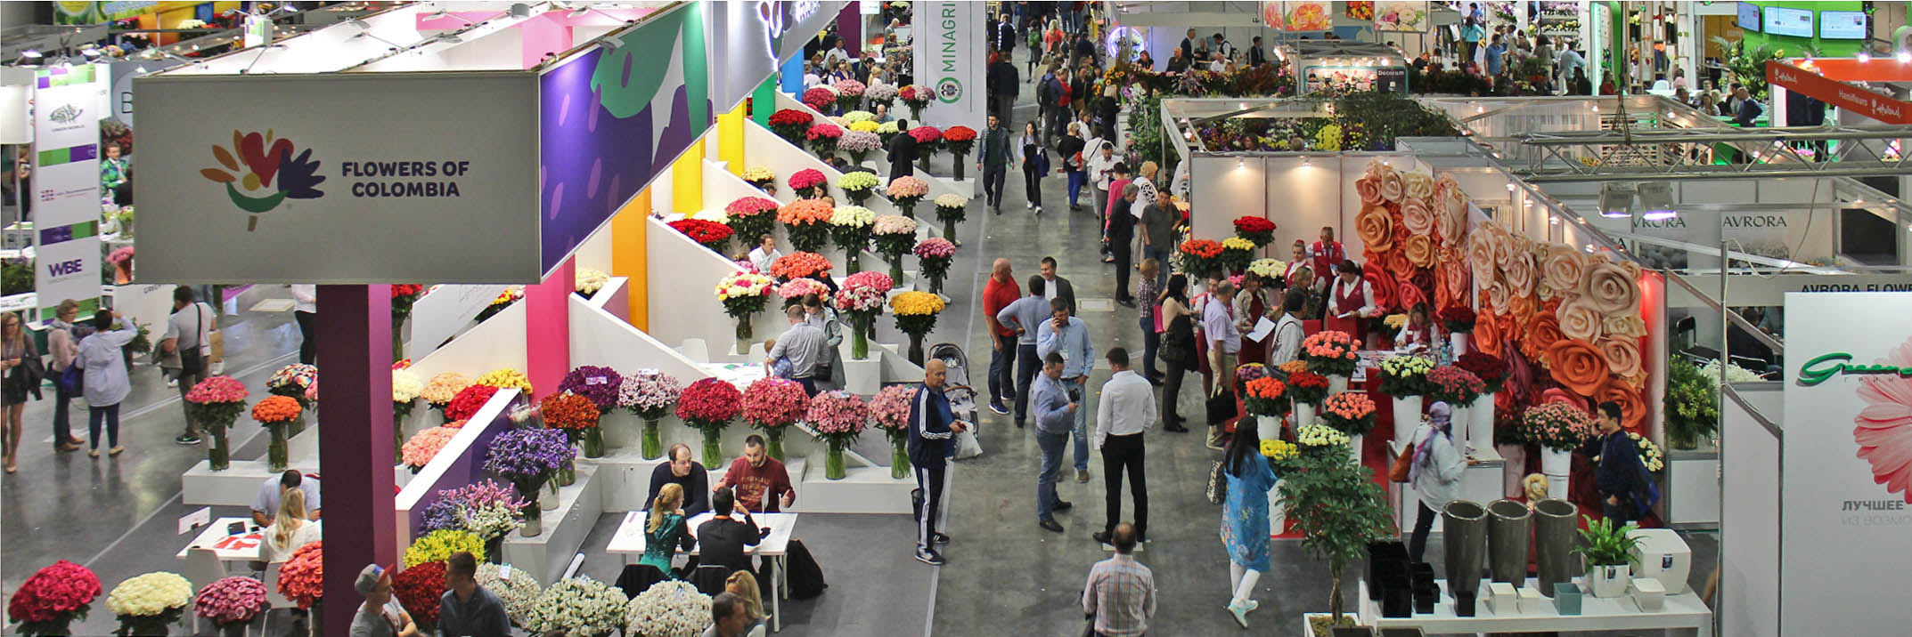

Exhibition Venue
International Exhibition Center Crocus Expo
Advanced exhibition complex on the territory of Russia disposes of optimum conditions for holding large international exhibitions
Crocus Expo is UFI member in categories Exhibition Organizer and Exhibition Center
IEC Crocus Expo:
549 000 sq. m of exhibition space,
3 Pavilions, 19 Exhibition Halls, 49 Conference Halls
20 000 free parking spaces for cars
Easy access for vehicles
35 minutes by metro from the city center.
Exit from Myakinino metro station is on the grounds
of Crocus Expo

Slide 10
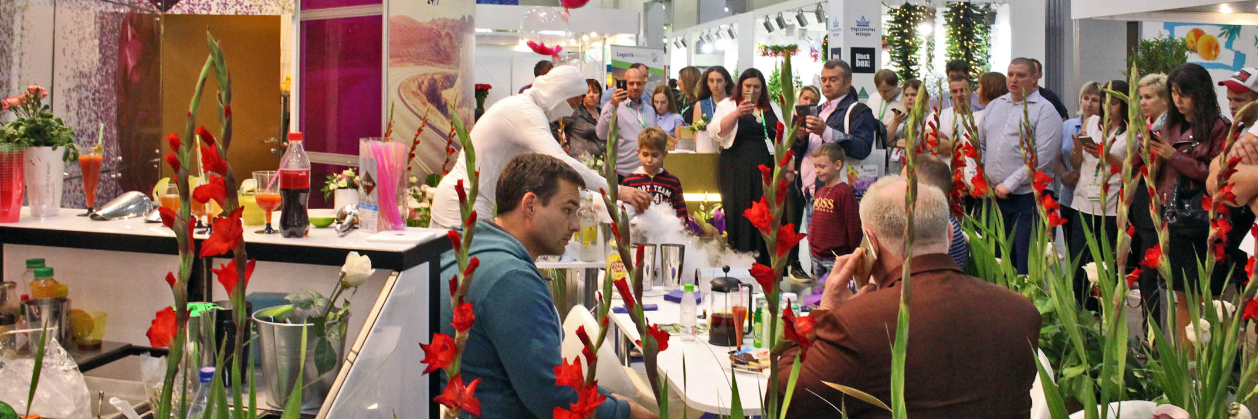
Business Program of the Trade Fair FlowersExpo-2019
50+ exhibition business events including conferences, presentations and numerous floral shows
3000+ participants of the exhibition business program
The championship of Russia on professional floristics Russian Florist Cup – the most important floral event of the year is organized in the frameworks of the exhibition
FlowersExpo is an effective platform for communication and learning

Slide 11
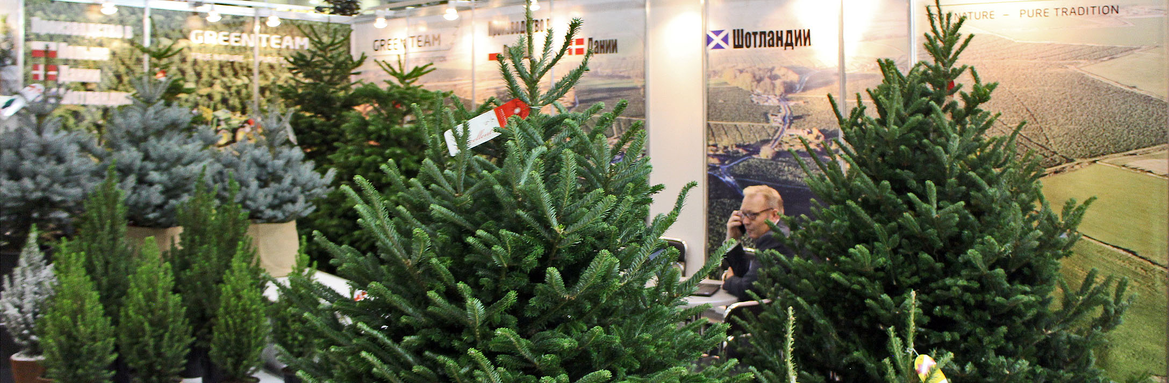






Exhibition Partners
Association “Greenhouses of Russia”
Association
“Greenhouses of Russia”
Association of Planting Stock Producers
National Guild of Florists
General Information Partner
“Flowers” magazine
General Internet Partner
Information Portal “GreenCom”
Exhibition Patronage
RF Chamber of Commerce and Industry

Slide 12
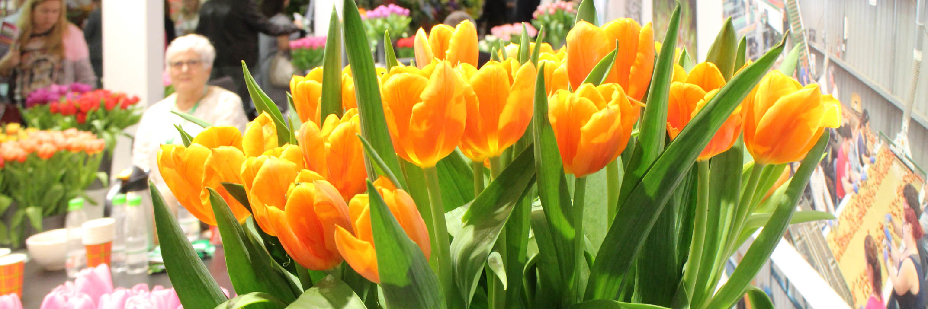












Exhibition Organizer
Exhibition Company “GreenExpo”
RUEF Member
IEC Crocus Expo, 143402, Moscow, Russia,
+7 495 221-12-51
mail@flowers-expo.ru
www.flowers-expo.ru

Slide 13
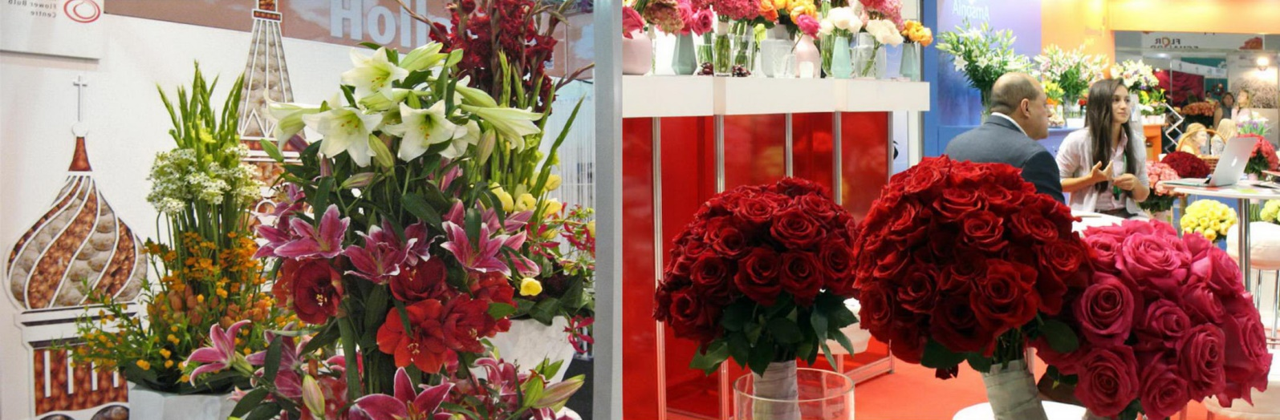

See You at
FlowersExpo-2019!
10 - 12 September, 2019
IEC Crocus Expo
Moscow, Russia

